Slide 1

Distributed Systems
Unit 2 ARCHITECTURES
Ling ZHOU
School of Computer Science and Engineering
College of Software Engineering,
Southeast University, Nanjing
ling.zhou@seu.edu.cn

Slide 2

Unit 2 – Architecture: Outline
Architectural styles
System architectures
Middleware organization
Example architectures
Summary

Slide 3
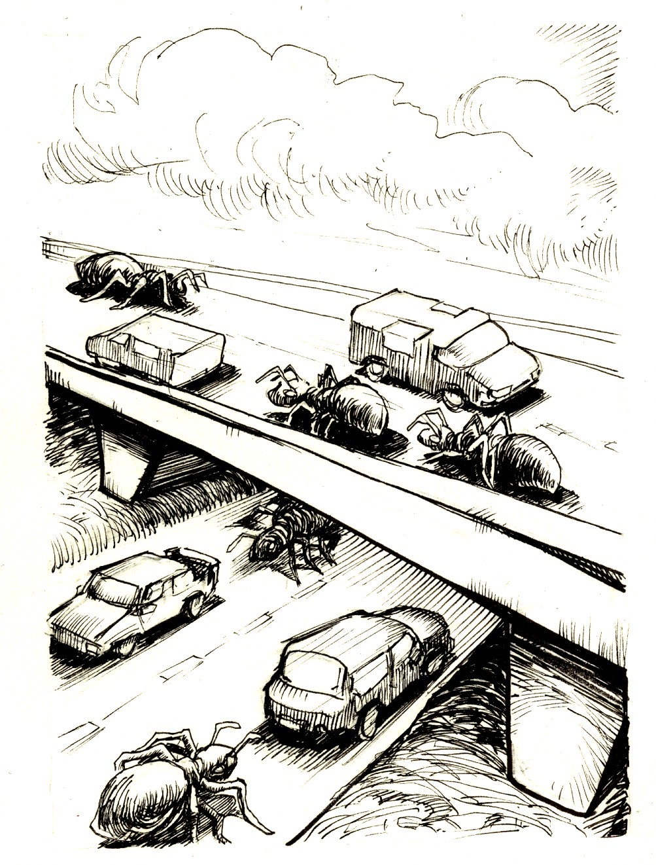
Organization of a DS
To master DS complexity, the systems need to be properly organized.
To make a distinction between
the logical organization of the collection of software components (software architecture)
the actual physical realization (system architecture)
how to instantiate and place software components on real machines
The organization of DS is mostly about software components

Slide 4

Architecture Styles (Software Architectures)
An architecture style is formulated in terms of
(replaceable) components with well-defined interfaces
the way that components are connected to each other
the data exchanged between components
how these elements are jointly configured into a system.
A connector is a mechanism that mediates communication, coordination, or cooperation among components
e.g., facilities for RPC, message passing, or streaming data
Notes:
Mediate vt.经调解解决; 斡旋促成
vi.调停，调解，斡旋
adj.居间的，间接的

Slide 5

Architecture Styles – Some Important Ones
Using components and connectors, we can come to various configurations
Layered architectures
Object-based architectures
Resource-centered architectures
Event-based architectures
Note
In most real-world distributed systems, many different styles are combined.

Slide 6
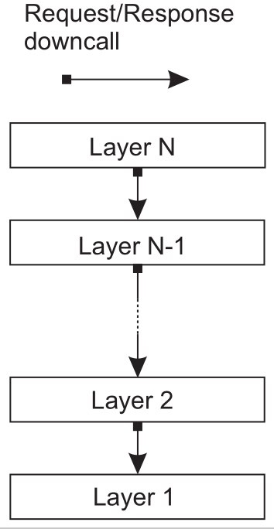
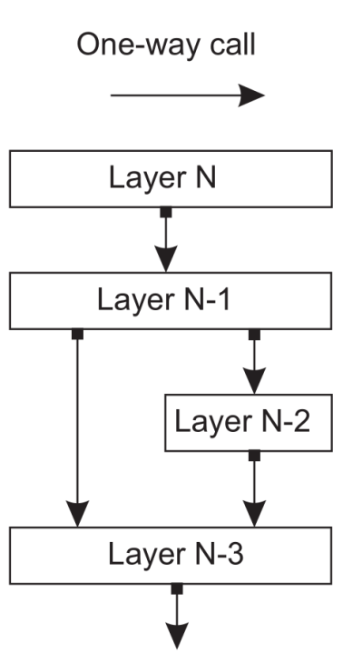
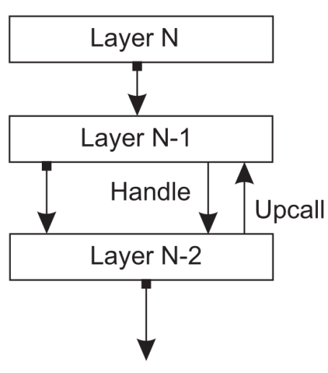
Layered architecture
Three common layered organizations
The basic idea is simple: components are organized in a layered fashion where a component at layer L_{j} can make a downcall to a component at a lower-level layer L_{i} (with i < j ) and generally expects a response.
Only in exceptional cases will an upcall be made to a higher-level component.
Pure layered
organization.
(b) Mixed layered
organization.
(c) Layered organization
with upcalls
Notes:
Figure 2.1(a) shows a standard organization in which only downcalls to
the next lower layer are made. This organization is commonly deployed in
the case of network communication.
In many situations we also encounter the organization shown in Fig-
ure 2.1(b). Consider, for example, an application A that makes use of a library
L OS to interface to an operating system. At the same time, the application uses
a specialized mathematical library L math that has been implemented by also
making use of L OS . In this case, referring to Figure 2.1(b), A is implemented at
layer N − 1, L math at layer N − 2, and L OS which is common to both of them,
at layer N − 3.
Finally, a special situation is shown in Figure 2.1(c). In some cases, it
is convenient to have a lower layer do an upcall to its next higher layer. A
typical example is when an operating system signals the occurrence of an
event, to which end it calls a user-defined operation for which an application
had previously passed a reference (typically referred to as a handle).
For example, in the case of a bank, we may want to
generate a notification when a customer’s credit card debt reaches a certain
value. This type of information can be maintained through a database trigger
that activates a handler for that trigger at the appropriate moment.

Slide 7
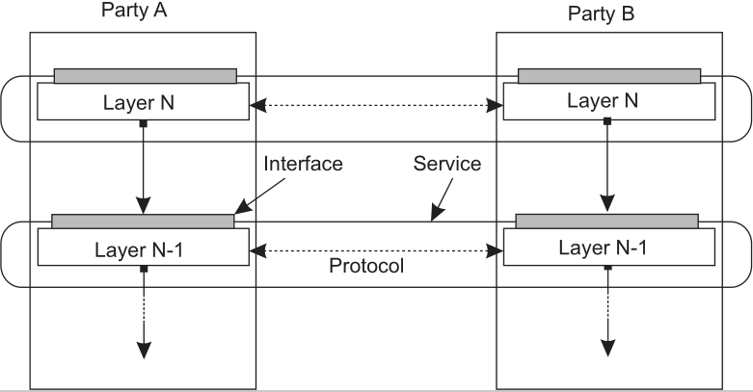
Example: communication protocols
A layered communication-protocol stack, showing the difference among a service, its interface, and the protocol it deploys,
(e.g., TCP).

Slide 8

Application Layering
Considering many client-server applications support user access to databases, if following the layered architectural style → traditional three-level view:
The user-interface level (e.g., display management)
The processing level (e.g., applications)
The data level
This layering is found in many distributed information systems

Slide 9
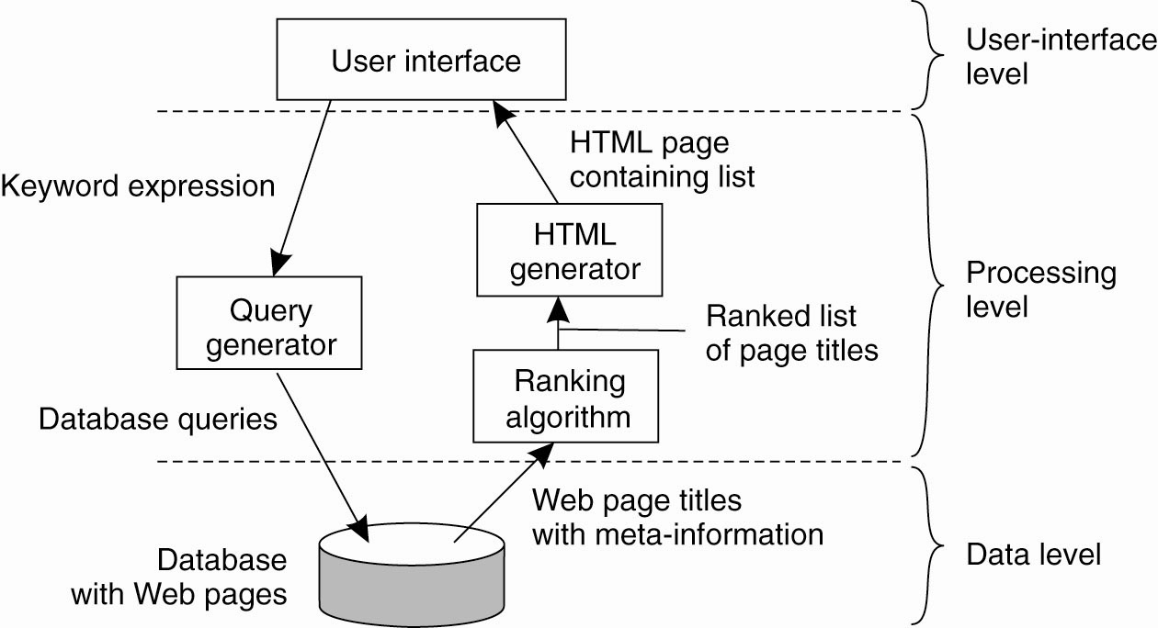
Processing Level
contains the core functionality of an application
…
Internet search
engine
Decision support system for a stock brokerage
Typical desktop package

Slide 10

Processing Level
contains the core functionality of an application
…
Internet search
engine
Decision support system for a stock brokerage
Typical desktop package
A front end implementing the user interface or offering a programming interface to external applications
A back end for accessing a database with the financial data.
The analysis programs between these two.
Analysis of financial data may require sophisticated methods and techniques from statistics and AI.
In some cases, the core of a financial decision support system may even need to be executed on high performance computers in order to achieve the throughput and responsiveness that is expected from its users.

Slide 11
Processing Level
contains the core functionality of an application
…
Internet search
engine
Decision support system for a stock brokerage
Typical desktop package
A typical desktop package, consisting of a word processor, a spreadsheet application, communication facilities, and so on.
Generally integrated through a common user interface.
The processing level consists of a relatively large collection of programs, each having rather simple processing capabilities.
The data level contains the programs that maintain the actual data.
Data are often persistent.
In its simplest form, the data level consists of a file system / a full-fledged database.

Slide 12
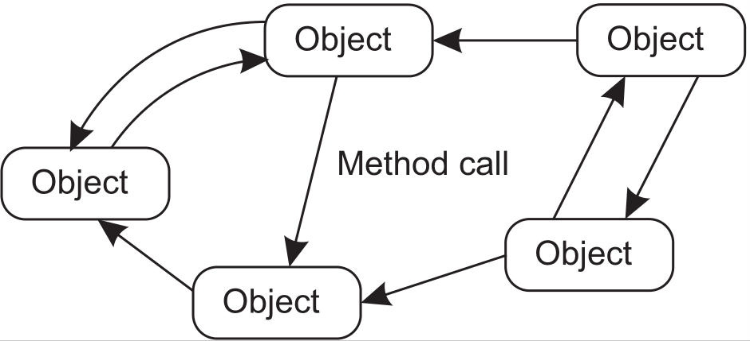
Object-based and service-oriented architectures (SOA)
Essence
Looser organization
Components are objects, connected to each other through (remote) procedure calls.
Objects may be placed on different machines; calls can thus execute across a network.
Encapsulation
Objects are said to encapsulate data (called an object’s state ) and offer methods on that data without revealing the internal implementation.
An object should be replaceable with one having exactly the same interface.

Slide 13
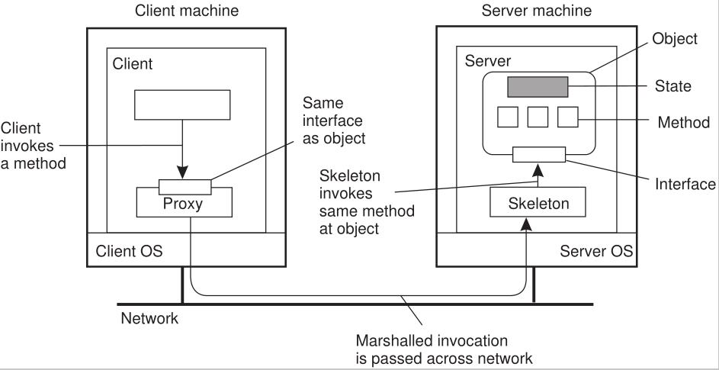
Distributed object
Common organization of a remote object with client-side proxy
A proxy is analogous to a client stub in RPC systems
The server-side stub is often referred to as a skeleton
Notes:
The server-side stub is often referred to as a skeleton as it provides the
bare means for letting the server middleware access the user-defined objects.
In practice, it often contains incomplete code in the form of a language-specific
class that needs to be further specialized by the developer.

Slide 14
Service-oriented architectures (SOA)
Object-based architectures form the foundation of encapsulating services into independent units.
Encapsulation: the service as a whole is realized as a self-contained entity, although it can possibly make use of other services.
By clearly separating various services such that they can operate independently → service-oriented architectures (SOA)
E.g., cloud computing: makes use of storage services offered by a cloud provider.
These storage services are logically completely encapsulated into a single unit, of which an interface is made available to customers.

Slide 15

Service composition
The problem of developing a distributed system is partly one of service composition , and making sure that those services operate in harmony.
A Web shop selling goods
an application for processing orders
operates on a local database containing
Order processing typically involves
Selecting items
Registering
Checking the delivery channel
handled by a separate service,
run by a different organization
Making sure that a payment takes place

Slide 16
Resource-based architectures
Mostly Web-based distributed systems are developed.
One of the problems with service composition is that connecting various components can easily turn into an integration nightmare.
As an alternative, one can also view a distributed system as
a huge collection of resources that are individually managed by components.

Slide 17
Representational State Transfer ( REST ) -- RESTful architectures
Essence
View a distributed system as a collection of resources, individually managed by components.
Resources may be added, removed, retrieved, and modified by (remote) applications.
Resources are identified through a single naming scheme
All services offer the same interface
Messages sent to or from a service are fully self-described
After executing an operation at a service, that component forgets everything about the caller

Slide 18
Resource-based architectures --On interfaces
Many people like RESTful approaches because the interface to a service is so simple.
The catch is that much needs to be done in the parameter space.

Slide 19
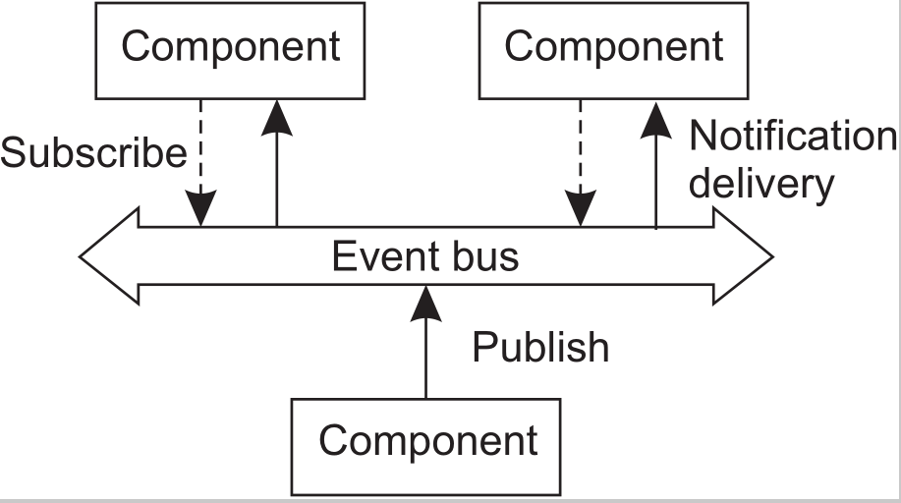
Event-based and Data-centered Style
Data-centered architectures:
processes communicate through a common (passive or active) repository
e.g., File-based or Web-based distributed systems
Event-based architectures:
processes communicate through the propagation of events (optionally carry data)
e.g., publish/subscribe systems
processes publish events after which the middleware ensures that only those processes that subscribed to those events will receive them
Advantage: processes are loosely coupled (decoupled in space or referentially decoupled: processes need not explicitly refer to each other)

Slide 20
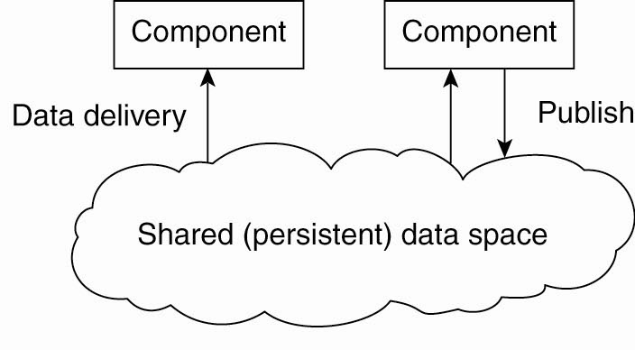
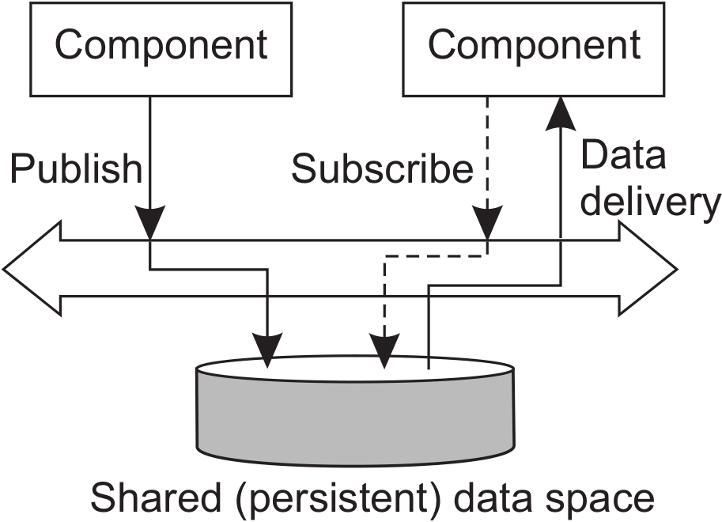
Shared Data Spaces
Combination of event-based architectures with data-centered architectures
Decoupled in time: Processes need not both be active when communication takes place.
Use a SQL-like interface to the shared repository
Data can be accessed using a description rather than an explicit reference, as is the case with files

Slide 21

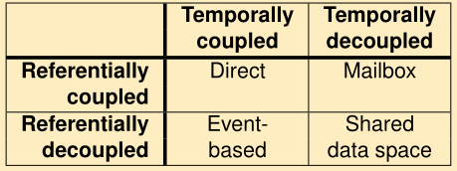
Publish-subscribe architectures Coordination
Temporal and referential coupling
Observation
Decoupling processes in space (“anonymous”) and also
time (“asynchronous”) has led to alternative styles.

Slide 22
Some Consideration
These software architectures all aim at achieving (at a reasonable level) distribution transparency
We have argued: distribution transparency requires making trade-off between performance, fault tolerance, ease of programming, …
No single solution will meet the requirement for all possible distributed applications → No single distributed system can be used to cover 90% of all possible cases.

Slide 23
System Architectures
Deciding on software components, their interaction, and their placement leads to an instance of a software architecture → system architecture
Centralized architectures
Decentralized architectures
Hybrid Forms

Slide 24
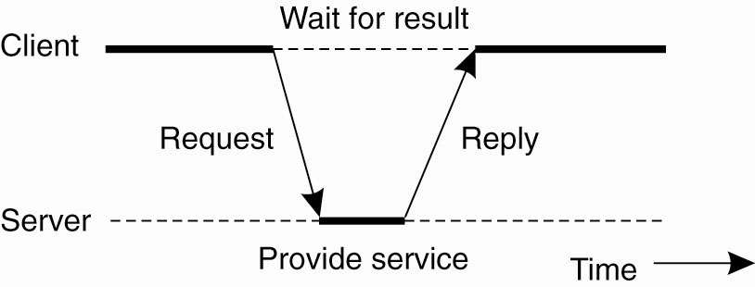
Centralized Architectures
Basic client-server (C/S) model
Processes in DS are divided into two (possibly overlapping) groups
A server is a process implementing/offering a service
A client is a process that requests/uses a service
Clients and servers can be on different machines
Communication: by a simple connectionless protocol (efficient in LAN) or a reliable connection-oriented protocol (fine in WAN)
General interaction between a client and a server, i.e., request-reply behavior

Slide 25
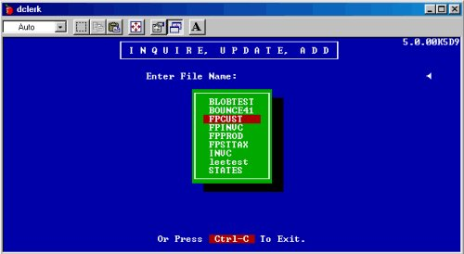


User-interface Level
Clients typically implement this level
Consists of different programs that allow end users to interact with applications
a character-based screen
User’s terminal doing some local processing
Advanced user interfaces offer more functionality
simplest
More advanced

Slide 26
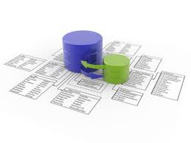
Data Level
Contains the programs that maintain the actual data on which the applications operate.
Important property: data are often persistent,
- i.e., even if no application is running, data will be stored somewhere for next use.
Typically implemented at the server side
Functions:
- Storing data
- Also responsible for keeping data consistent across different applications
Relational databases: Data independence are crucial
- Helps separate the processing level from the data level

Slide 27
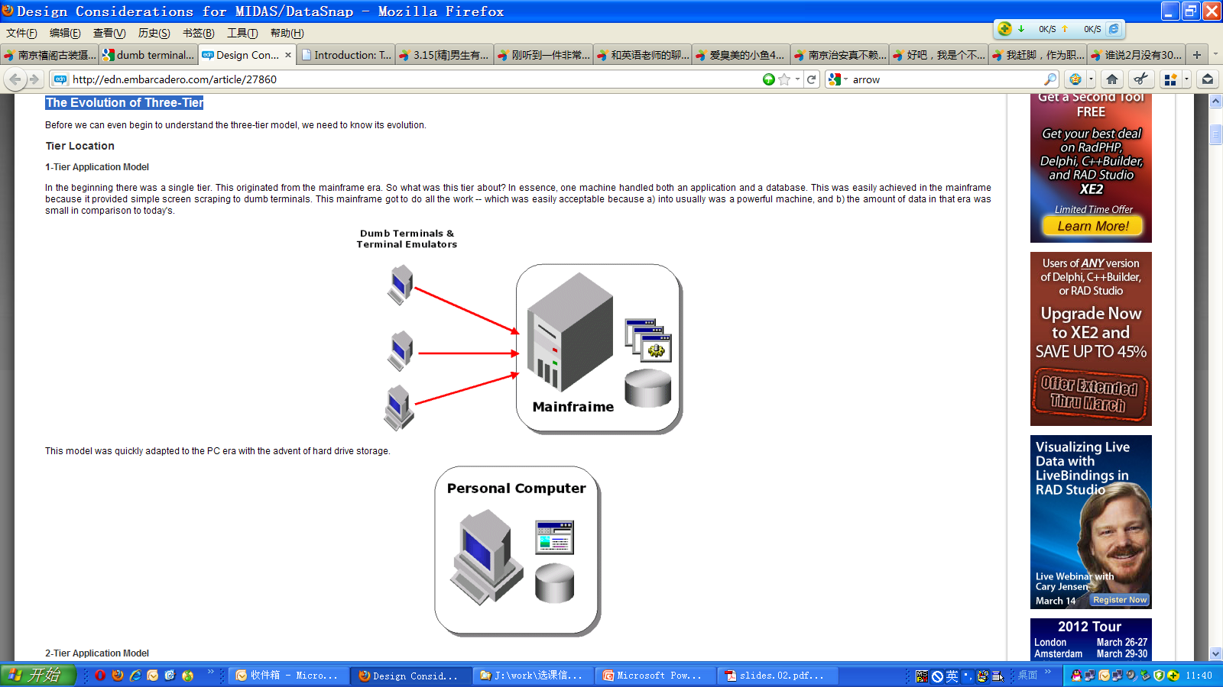
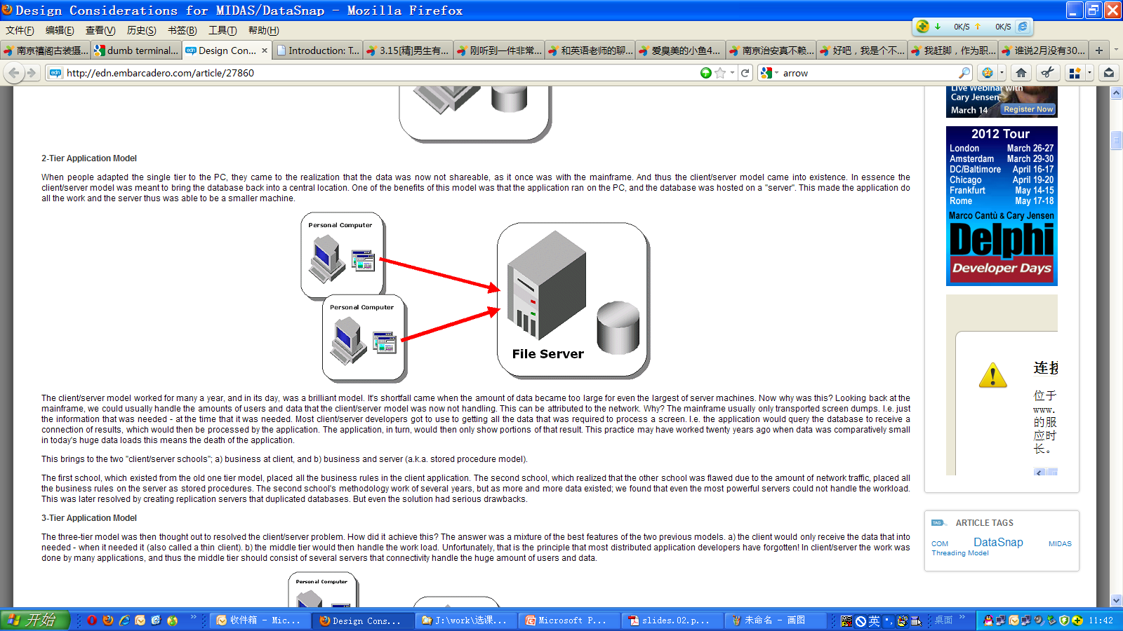
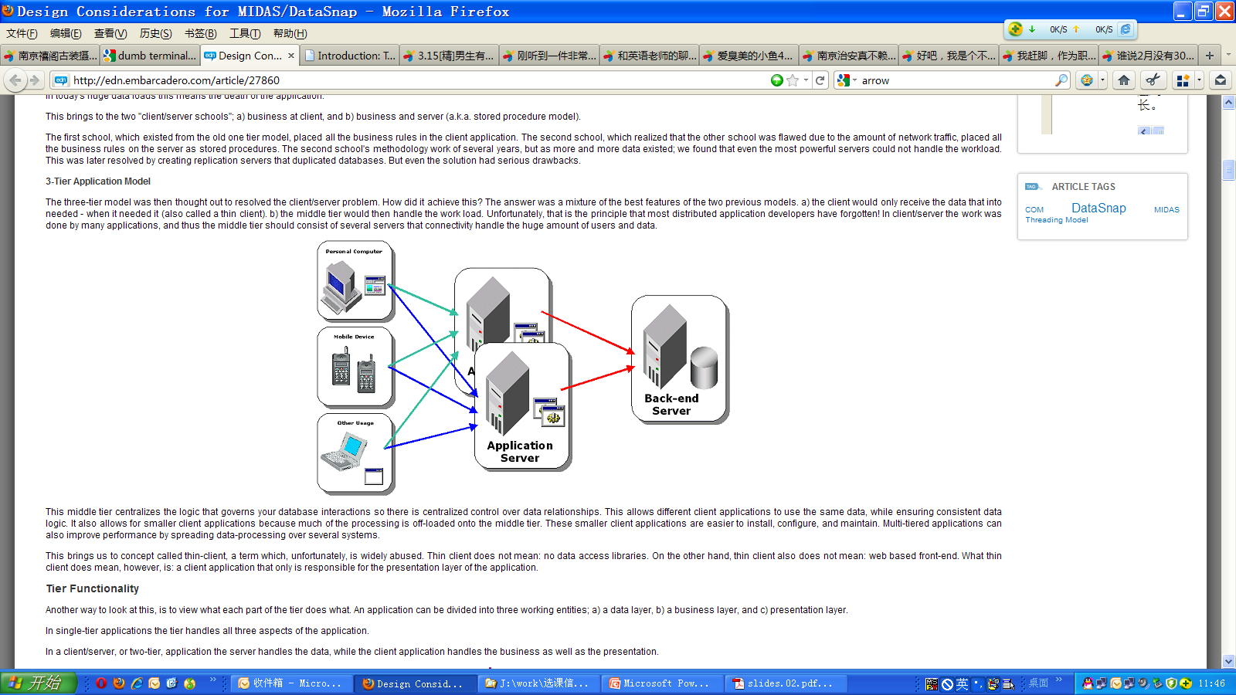
Multi-tiered Architectures
Some traditional organizations
Single-tiered:
dumb terminal/mainframe configuration
Two-tiered:
client/single server configuration
Three-tiered:
each layer on separate machine

Slide 28
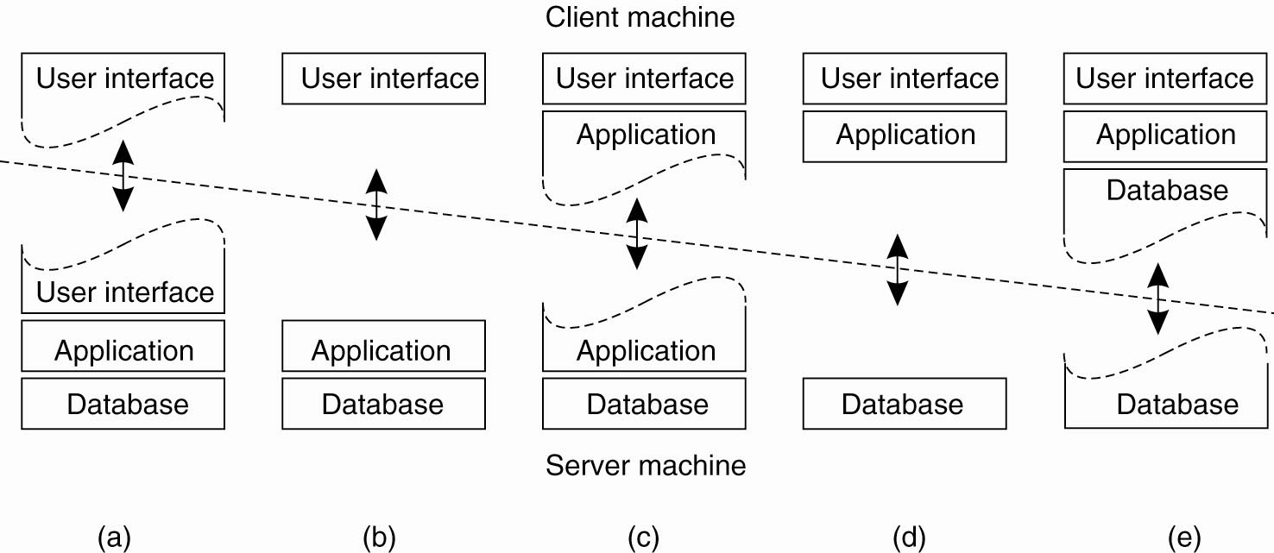
Physically two-tiered architecture
Most processing + some data storage
No processing
popular
thin clients
Fat clients
Alternative client-server organizations (a)-(e)

Slide 29
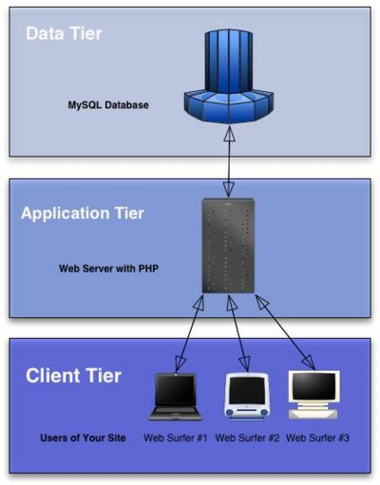
Trend to Thin Clients
Fat clients:
Not optimal from a system’s management perspective (more functionality, more problematic management)
Client-side software prone to errors and dependent on the client’s platform
Thin clients:
Easier management
But less sophisticated UI and client-perceived performance
Server-side solutions become more distributed by multiple servers running on different machines

Slide 30
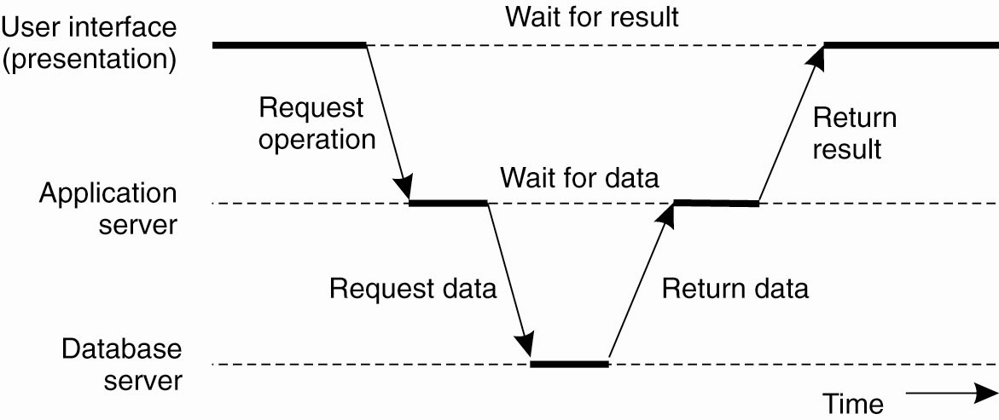
Three-Tiered Architecture An example of an application server acting as client

Slide 31
Summary of Multi-Tier Architecture (n-tier Architecture)
Multi-tier architecture is a client–server architecture
in which the functions such as presentation, application processing, and data management are physically separated.
By separating an application into tiers, developers obtain the option of changing or adding a specific layer, instead of reworking the entire application.
It provides a model by which developers can create flexible and reusable applications.
The most general use of multi-tier architecture is the three-tier architecture.

Slide 32
System Architectures
Deciding on software components, their interaction, and their placement leads to an instance of a software architecture → system architecture
Centralized architectures
Decentralized architectures
Hybrid Forms

Slide 33
Decentralized Architectures
Two ways of organizing client-server applications
Vertical distribution
Placing logically different components on different machines
E.g., multi-tiered architecture
Horizontal distribution
A client or server may be physically split up into logically equivalent parts, but each part is operating on its own share of the complete data set, thus balancing the load
E.g., modern peer-to-peer systems (P2P)

Slide 34


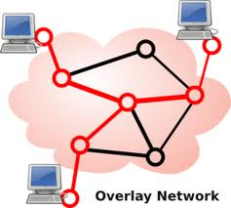
Peer-to-Peer System (P2P)
Characteristics:
Processes that constitute a P2P are equal
Symmetric behavior: Much of the interaction between processes is symmetric
Each process will act as a client and a server at the same time (called a servent)
How to organize the processes in an overlay network?
Structured P2P (nodes are organized following a specific distributed data structure)
Unstructured P2P (nodes have randomly selected neighbors)
Note:
In virtually all cases, we are dealing with overlay networks: data is
routed over connections setup between the nodes

Slide 35
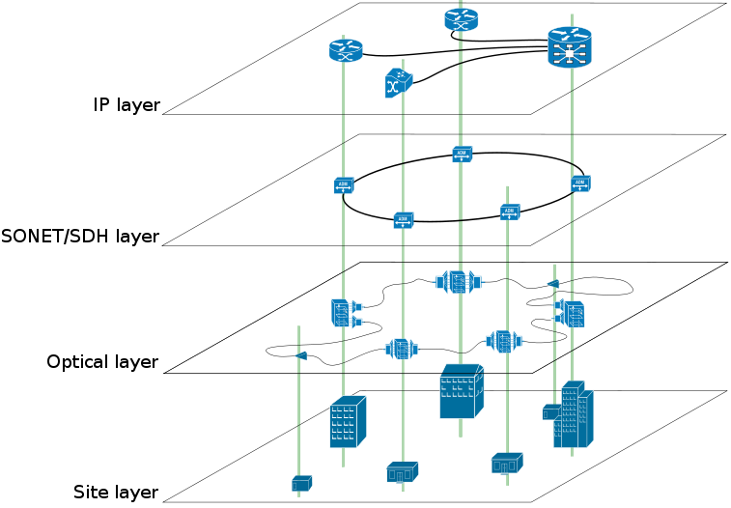
About Overlay network
A computer network which is built on the top of another network.
Nodes in the overlay can be thought of as being connected by virtual or logical links
For example:
distributed systems such as cloud computing, P2P, and client-server applications are overlay networks because their nodes run on top of the Internet.
The Internet was built as an overlay upon the telephone network.

Slide 36
Structured Peer-to-Peer Architecture
Membership management: Constructing the overlay network using a deterministic procedure.
The most-used procedure is to organize the processes through a distributed hash table (DHT).
provides a lookup service similar to a hash table;
(key, value) pairs are stored in a DHT;
any participating node can efficiently retrieve the value associated with a given key;
responsibility for maintaining the mapping from keys to values is distributed among the nodes,

Slide 37
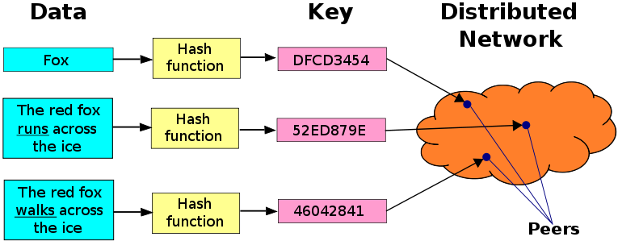
Distributed Hash Table (DHT)
DHTs form an infrastructure that can be used to build more complex services,
such as anycast, cooperative Web caching, distributed file systems, domain name services, instant messaging, multicast, and also peer-to-peer file sharing and content distribution systems.
Notable distributed networks that use DHTs include
BitTorrent's distributed tracker, the Coral Content Distribution Network, the Kad network, the Storm botnet, and YaCy.

Slide 38
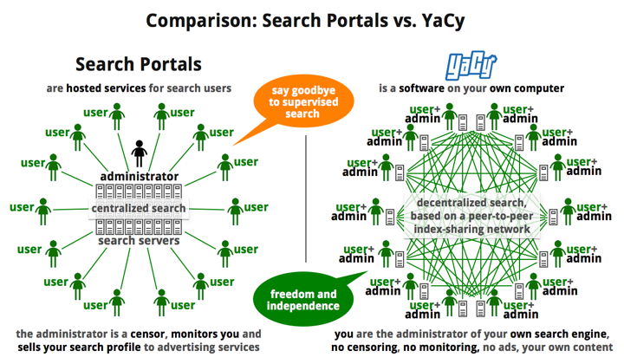
YaCy -- a free distributed search engine

Slide 39
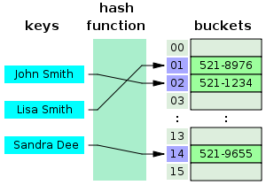
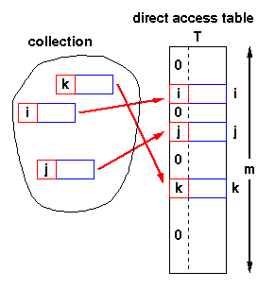
About Hash Table
A hash table or hash map is a data structure that uses a hash function to map identifying values, known as keys (e.g., a person's name), to their associated values (e.g., their telephone number).
Hash function is used to transform the key into the index (the hash) of an array element.
index = f(key, arrayLength)
Hash collisions—different keys that map to the same hash value
must be accommodated in some way.
Allows arbitrary insertions and deletions of key-value pairs

Slide 40
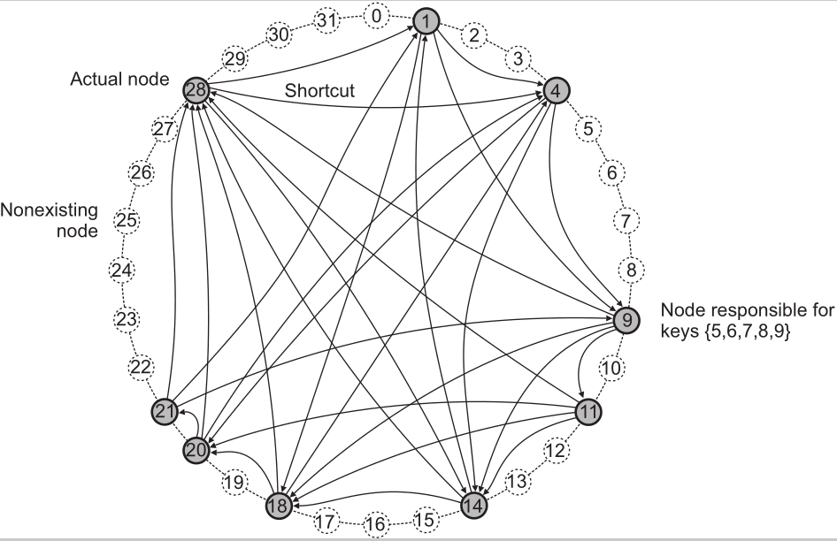
Example 1: Chord system
Principle
Nodes are logically organized in a ring.
Each node has an m-bit identifier.
Each data item is hashed to an m-bit key.
lookup(3)@9 : 28 → 1 → 4
Data item with key k is stored at node with smallest identifier id ≥ k,
called the successor of key k.
The ring is extended with various shortcut links to other nodes.

Slide 41
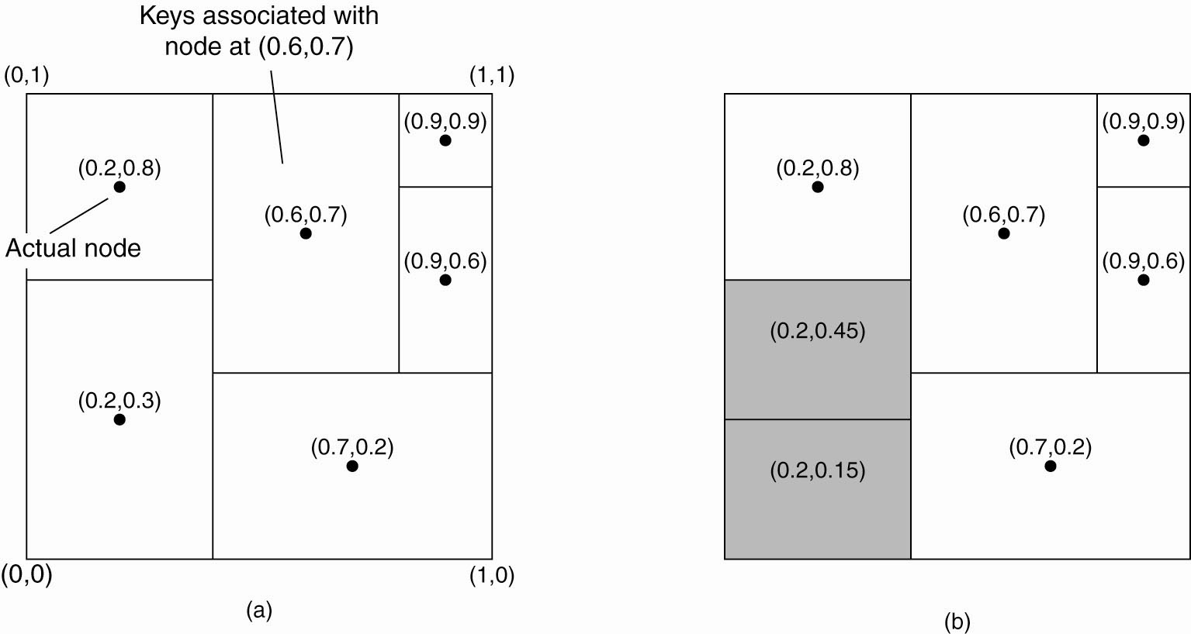
Example 2: Content Addressable Network (CAN)
CAN deploys a d-dimensional Cartesian coordinate space, partitioned among all the nodes. Let every node take the responsibility for data in a specific region.
When a node joins ⇨ split a region; nodes’ leaving is a bit more problematic
Two-dimentional space [0,1]x[0,1] is divided among six nodes
Each node has an associated region
Every data item is assigned a unique point for responsibility

Slide 42
Unstructured P2P
Essence
Each node maintains an ad hoc list of neighbors. The resulting overlay
resembles a random graph: an edge <u,v> exists only with a certain probability P[<u,v>].
Searching
Flooding: issuing node u passes request for a data item d to all neighbors.
Request is ignored when receiving node had seen it before. Otherwise, v searches locally for the requested d (recursively).
May be limited by a Time-To-Live: a maximum number of hops.
Random walk: issuing node u passes request for d to randomly chosen neighbor, v.
If v does not have d, it forwards request to one of its randomly chosen neighbors, and so on.
Between flooding and random walks lie policy-based search methods

Slide 43

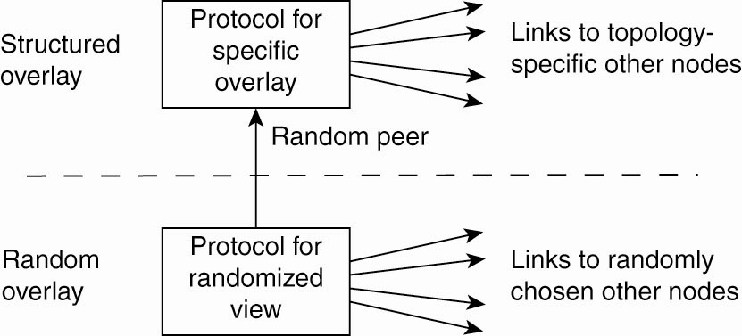
Topology Management of Overlay Networks
Key observation: by carefully exchanging and selecting entries from partial views, it is possible to construct and maintain specific topologies of overlay networks
Additional selection of entries takes place on the higher layer ⇨ a second list of neighbors corresponding to the desired topology
Lower layer passes its partial view to the higher layer, i.e., feeds random nodes
Lower layer maintains an accurate random graph

Slide 44
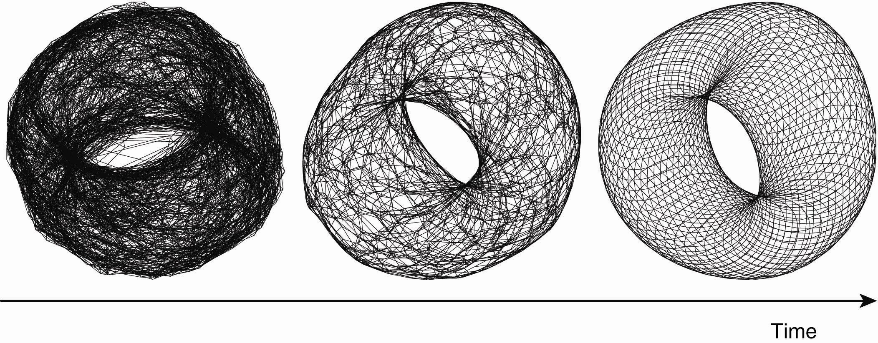
Constructing a torus using a two-layered unstructured P2P system
Consider a N× N grid. Keep only references to nearest neighbors:
The distance between nodes at (a₁, a₂) and (b₁, b₂)
||(a₁, a₂) - (b₁, b₂) || = d₁+ d₂, with d_{i} = min(N-|a_{i}-b_{i}|, | a_{i}-b_{i} |)

Slide 45
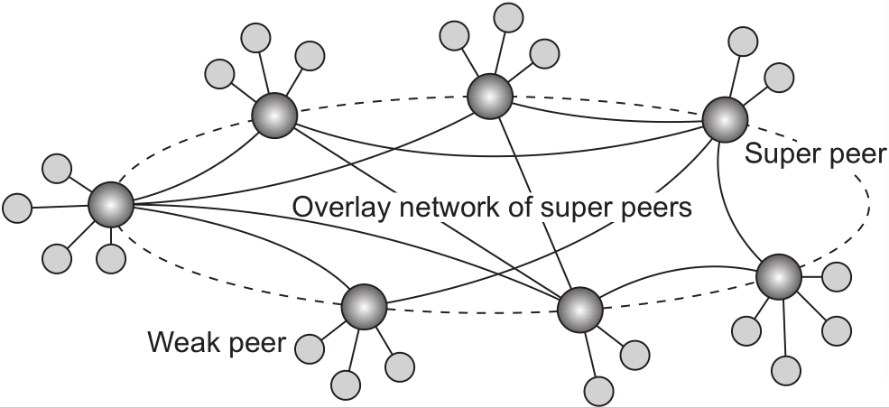
Hierarchically organized peer-to-peer networks Superpeers
Notably in unstructured P2P systems, locating relevant data items can become problematic
As there is no deterministic way of routing a lookup request to a specific data item; can only depend on flooding/random walk
Alternative way: Nodes maintaining an index or acting as a broker are referred to as superpeers, which are often organized in a P2P network
Leader-election problem: how to select superpeers?
A hierarchical organization of nodes into a superpeer network
In many cases, the client-superpeer relation is fixed; in some cases, the relation can change as clients discover better superpeers to associate with
Notes:
peer-to-peer networks offer a flexible means for nodes to join and leave the network.
However, with super-peer networks a new problem is introduced, namely how to select the nodes that are eligible to
become super peer.

Slide 46

Skype’s principle operation: A wants to contact B (P2P)
Both A and B are on the public Internet
A TCP connection is set up between A and B for control packets.
The actual call takes place using UDP packets between negotiated ports.
A operates behind a firewall, while B is on the public Internet
A sets up a TCP connection (for control packets) to a super peer S
S sets up a TCP connection (for relaying control packets) to B
The actual call takes place through UDP and directly between A and B
Both A and B operate behind a firewall
A connects to an online super peer S through TCP
S sets up TCP connection to B .
For the actual call, another super peer is contacted to act as a relay R : A
sets up a connection to R , and so will B .
All voice traffic is forwarded over the two TCP connections, and through R .

Slide 47
System Architectures
Deciding on software components, their interaction, and their placement leads to an instance of a software architecture → system architecture
Centralized architectures
Decentralized architectures
Hybrid Forms
Many distributed systems combine architectural features, e.g., superpeer networks, and some specific classes of distributed systems which combine C/S solutions and decentralized architectures.

Slide 48
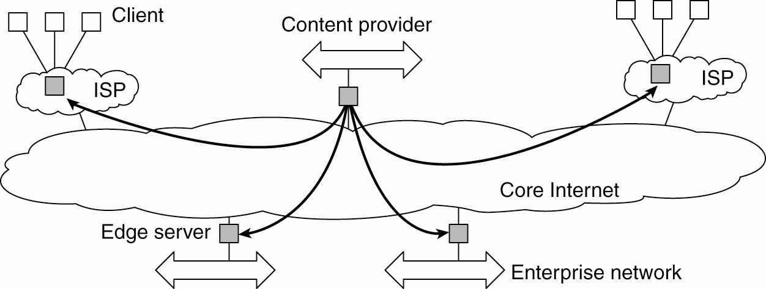
Hybrid Architectures Client-server combined with P2P (1)
Example 1: Edge-server systems
For a specific organization, one edge server acts as an origin server
The origin server can use other edge servers for replicating Web pages and such
A collection of edge servers can be used to optimize content and application distribution
? Where is C/S part and where is P2P part?

Slide 49

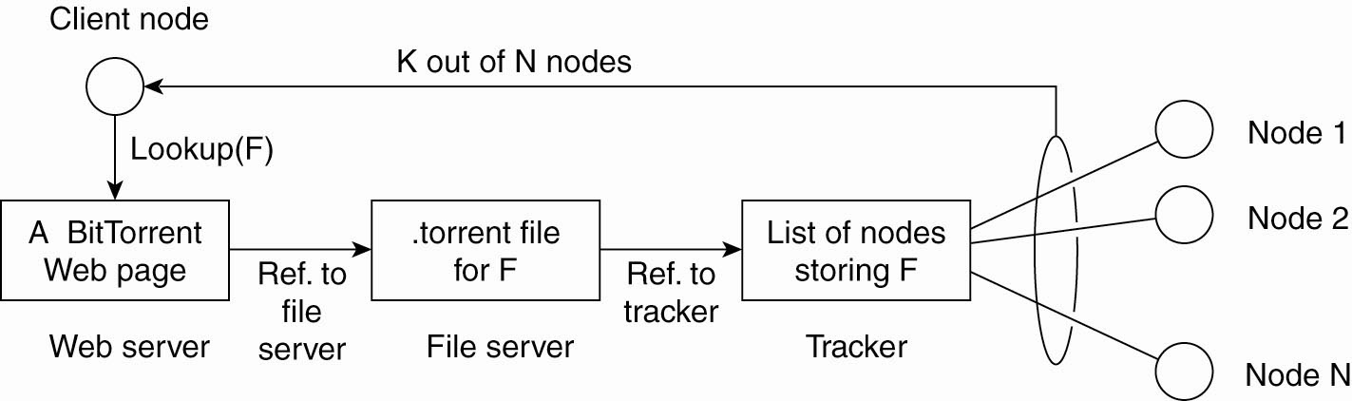
Hybrid Architectures Client-server combined with P2P (2)
Example 2: Collaborative distributed systems
(e.g., BitTorrent file-sharing system)
A tracker : a server keeping an accurate account of active (downloading) nodes
A fully decentralized scheme for collaboration: Active (downloading) nodes is forced to help others, e.g., by providing chunks of the file it is downloading
Bottleneck of the system is formed by the trackers.
swarm
? Where is C/S part and where is P2P part?
/search engine
/chunks of F

Slide 50


Hybrid Architectures Client-server combined with P2P (3)
Example 3: Globule collaborative content distribution network (CDN)
Resembles the edge server architecture
Instead of edge servers, the end users voluntarily provide enhanced Web servers that are capable of collaborating in the replication of Web pages
Origin server has at least the following components:
A component that can redirect client requests to other servers
A component for analyzing access patterns
A component for managing the replication of Web pages
A centralized component in the form of its broker which is responsible for registering servers and making these servers known to others (analogous to C/S system)
? Where is C/S part and where is P2P part?

Slide 51



Using legacy to build middleware
Problem
The interfaces offered by a legacy component are most likely not suitable for all applications.
Solution
A wrapper or adapter offers an interface acceptable to a client application.
Its functions are transformed into those available at the component.

Slide 52
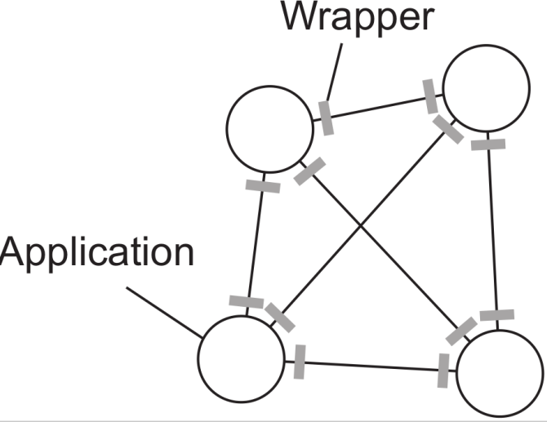
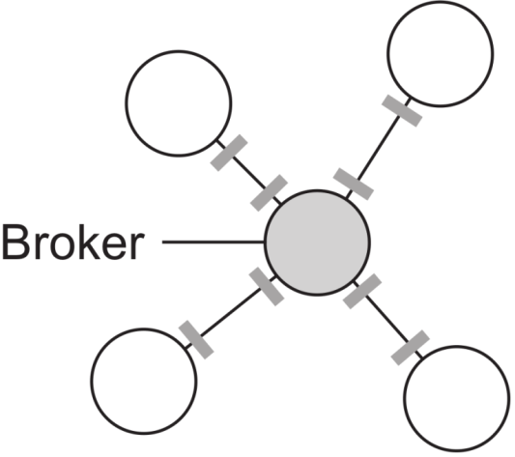
Organizing wrappers -- Two solutions
1-on-1 through a broker
Complexity with N applications
1-on-1: requires N ×(N −1) = O(N² ) wrappers
broker: requires 2N = O(N) wrappers

Slide 53



Developing adaptable middleware
Problem
Middleware contains solutions that are good for most applications
⇒ you may want to adapt its behavior for specific applications

Slide 54



Architecture vs. Middleware
Common practice: middleware systems follow a specific architectural style, for example,
CORBA: a middleware adopting an object-based style
TIB/Rendezvous: a middleware adopting an event-based style
designing applications may become simpler
the chosen style may not be optimal in all cases
need to (dynamically) adapt the execution behavior of the middleware (NOT the software components they comprise).
Middleware systems need to be easy to configure, adapt and customize

Slide 55
A means to adapt the middleware
Interceptor − A software construct that will break the usual flow of control and allow other code to be executed.
Note
To make interceptors generic may require a substantial implementation effort
It is unclear whether generality should be preferred over restricted applicability and simplicity.
In many cases, having only limited interception facilities will improve management of the software and distributed system as a whole

Slide 56
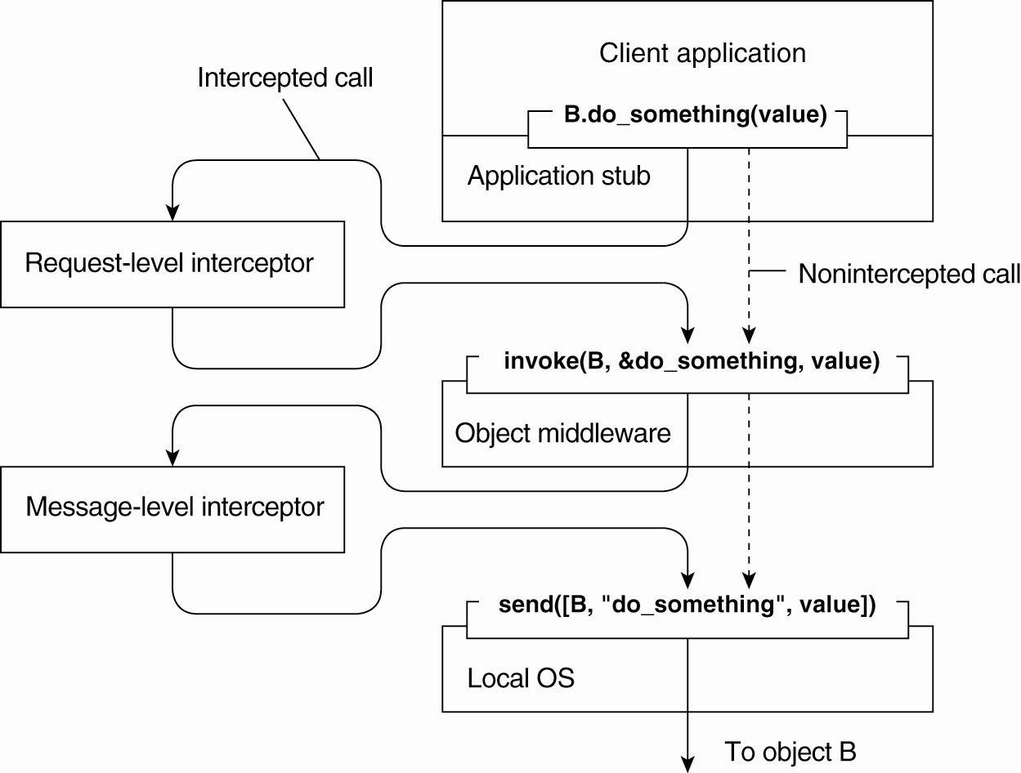
Interception in a remote-object invocation
Only the interceptor know about B’s replication and call for each of the replicas
Transformed into a generic call
Transformed into a message sent through the network
Transparently handle a fragmentation of the data

Slide 57

Background of Adaptive Software
The need for adaptation comes from the fact that the software should be allowed to change as the environment changes
Changes include those resulting from mobility, a strong variance in the QoS of networks, failing hardware, and battery drainage, …
Rather than making applications responsible for reacting to changes, this task is placed in the middleware
However, adaptive software has not been as successful as anticipated.

Slide 58

General Approaches to Adaptive Software
Separation of concerns
Relates to the traditional way of modularizing systems
Separate and subsequently weave extra functionalities (such as reliability, performance, security, etc.) into a system
Not easy and only toy examples so far
E.g., simply putting security into a separate module is not going to work
Computational reflection
Refers to the ability of a program to inspect itself at runtime and, if necessary, adapt its behavior dynamically
Mostly at language level and applicability unclear.
Reflection has been built into programming language (e.g., Java)
Some middleware systems have applied reflective techniques
Component-based design
Organize a distributed application through components that can be dynamically replaced when needed
highly complex, also many intercomponent dependencies

Slide 59

Discussion about adaptive software
Middlewares are generally bulky and complex.
The need for flexibility ⇨ complexity
Is the complexity of DS an inherent feature of reaching distribution transparency?
Is adapting to a changing environment a good reason to adopt changing the software?
The strongest and most valid argument for supporting adaptive software is that many distributed systems cannot be shut down.
Calls for solutions to replace and upgrade components on the fly
Unclear whether any proposed solutions are best
Hot plugging

Slide 60

Self-management in DS
When adaptation needs to be done automatically, there is a strong interplay between system architectures and software architecture.
Need to organize the components of DS
Need to decide where the processes are to be executed to handle the adaptation
Automatic adaptations to changes, i.e., autonomic computing / self-star systems, and many variants:
Self-configuring, self-managing, self-healing, self-optimizing,
Self-*
Warning
There is a lot of hype going on in this field
of autonomic computing.
Notes:
hype 搜索网络
英 [haɪp] 美 [haɪp]
n.天花乱坠的广告宣传
vt.大肆宣传; 夸张地宣传（某人或某事物）

Slide 61
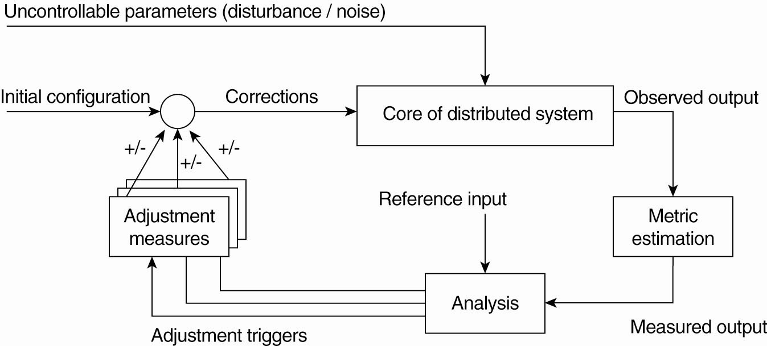
Feedback Control Model
In many cases, self-* DS are organized as a high-level feedback control system. (Figure: logical organization)
How does physical organization look like?
Mechanisms to influence the behavior of the system
Monitor and measure
Compare with references

Slide 62
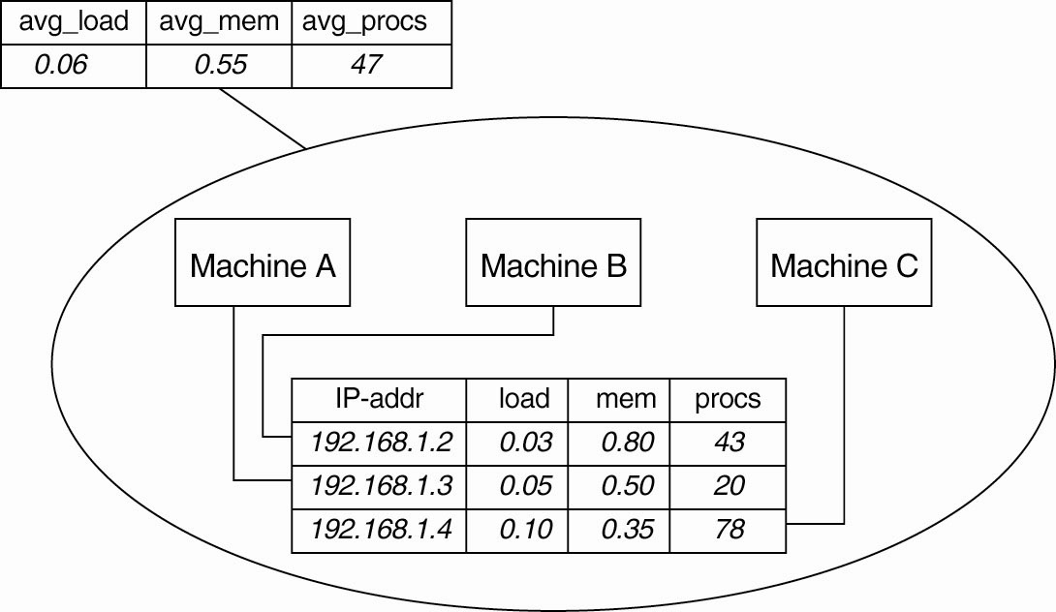
Example 1: Systems Monitoring with Astrolabe
Astrolabe organizes a large collection of hosts into a hierarchy of zones
Three hosts, A, B and C grouped into a zone
Each machine keeps track of its local information
At the zone level, only aggregated information can be collected (e.g., average values).
Through information exchange, all agents will see the same results (provided that no changes occur in the meantime)

Slide 63

Example 2: Differentiating Replication Strategies in Globule
Academic CDN
As of February 2011 the project is discontinued and is no longer maintained.
Guillaume Pierre and Maarten van Steen
Collaborative CDN that analyzes traces (i.e., from where a request for a page originated) to decide the best policy, e.g., where replicas of Web content should be placed and how to keep replicas consistent
The simple model allows an origin server to see what would have happened if it had placed a replica on a specific edge server.
On one hand, placing a replica closer to clients would improve client-perceived latency, but this will induce traffic between the origin server and that edge server in order to keep a replica consistent with the original page.

Slide 64
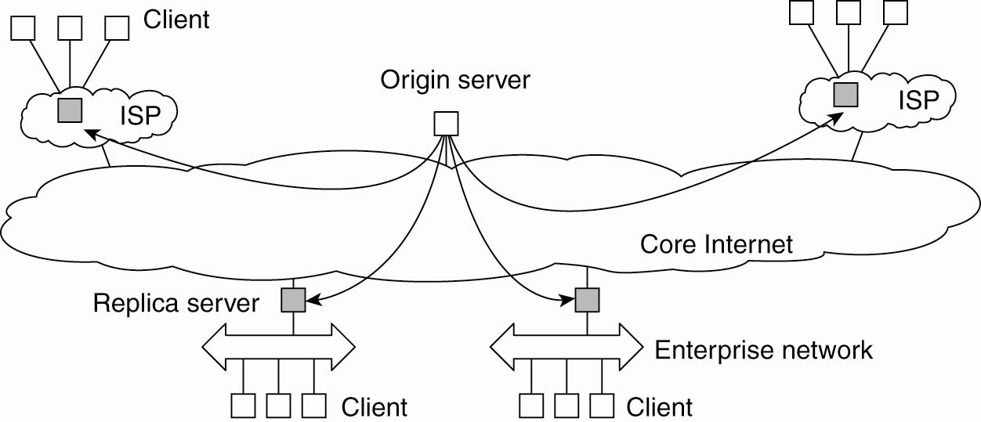
The edge-server model assumed by Globule
Globule origin server collects traces and does what-if analysis by checking what would have happened if page P would have been placed at edge server S.
Many strategies are evaluated, and the best one is chosen.

Slide 65
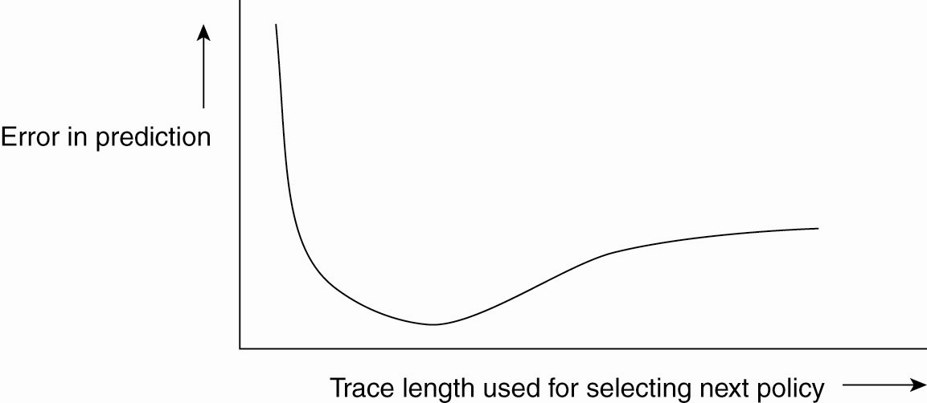
Globule: Dependency between prediction accuracy and trace length
Error in predicting the best policy goes up if the trace is not long enough
REASON: We need enough request to do a proper evaluation
Error also increases if we use too many requests
REASON: A very long trace length captures so many changes in access patterns that predicting the best policy to follow becomes difficult
Analogous to weather prediction
A better prediction can be made by just looking at the recent past
The following operations are done automatically
Collecting of traces
Evaluation of replication policies
Enforcement of a selected policy
Finding the optimal trace length

Slide 66
Example 3: Automatic Component Repair Management in Jade
Jade is an example of self-management
Each node is equipped with failure detectors
Upon the detection of a failure, a repair policy is automatically executed
Being a component-based system, this automatic repair requires specific support to allow components to be added and removed at runtime

Slide 67
Summary
layering
Object orientation
Software architecture (Architectural styles)
Event orientation
Data-space orientation
DS
Self-management in DS
(feedback control model)
Centralized (C/S)
System architecture
Decentralized
Hybrid

Slide 68

Topics of Seminar 2
Broker Architectural Style (CORBA)
https://www.tutorialspoint.com/software_architecture_design/pdf/distributed_architecture.pdf
Distributed Database Architecture (Oracle)
https://docs.oracle.com/cd/B28359_01/server.111/b28310/ds_concepts001.htm#ADMIN12074
Content Delivery Network (CDN)
https://en.wikipedia.org/wiki/Content_delivery_network
https://www.incapsula.com/cdn-guide/
Comparison between P2P and C/S architectures
https://www.computer.org/csdl/proceedings/p2p/2001/1503/00/15030101.pdf
https://www.ianswer4u.com/2011/05/peer-to-peer-network-p2p-advantages-and.html
https://study.com/academy/lesson/network-architecture-tiered-peer-to-peer.html

Slide 69
Topics of Seminar 2 (Continue…)
5. How does BitTorrent work? List some famous P2P applications/software.
https://en.wikipedia.org/wiki/BitTorrent
https://www.symantec.com/connect/articles/what-do-p2p-applications-do-and-how-block-peer-peer-applications-p2p-using-symantec-endpoin
6. publish/subscribe systems
https://en.wikipedia.org/wiki/Publish%E2%80%93subscribe_pattern
https://www.embedded.com/design/system-integration/4459162/Getting-started-with-publish-subscribe-messaging-systems
B/S architecture
http://www.differencebetween.net/technology/software-technology/difference-between-client-server-application-and-web-application/
https://www.differencebtw.com/difference-between-web-server-and-web-browser/
Based on the textbook, please give your understanding about SOA

Slide 70
Topics of Seminar 2 (Continue…)
The SKYPE network
NFS
Web-based system

